Slide 1

Time series data analysis and forecast methods
Lecture 4
Time series decomposition into components

Slide 2

Lecture map
Definition of time series separability
Decomposition of stationary time series
Trend estimation with regression methods
Trend estimation with smoothing methods
Periodic components retrieval from stationary time series

Slide 3
PART 1. TIME SERIES SEPARABILITY

Slide 4
Additive time series model
trend (or tendency);
j seasonal component (season);
k periodic component (cycle),
coefficients of presence or lack of components

Slide 5
Time series separability
We try to decompose time series into deterministic components/modes and stochastic residual, to reconstruct the model
Let is a time series with exactly m components
Separability of this F into exactly m components is a measure of accuracy for a denoted algorithm

Slide 6
Time series separability
Every component F_{i} has its own linear space
The time series has a weak separability with denoted method, if the bases are orthogonal;
The time series has a strong separability with denoted method, if the bases are orthogonal and disjoint;
The time series with strong separability has an absolute accuracy of its decomposition into any number of components

Slide 7
Time series separability
Strong separability = high accuracy
In practice strong separability is unattainable
In most cases we have another type of separability:
Approximate separability
Asymptotic separability
We can estimate the orthogonal property between linear spaces with independence measure between their generated time series = correlation

Slide 8
Time series separability
Approximate separability
Coefficient of correlation is close to zero
Asymptotic separability
Coefficient of correlation is close to zero with the increasing number of observations

Slide 9
PART 2. TREND ESTIMATION for TIME SERIES

Slide 10
Trend estimation
Trend is a long-term stable non-periodic tendency (some times even monotonic)
Two type of methods:
Regression analysis
= data fitting, line fitting, curve fitting, etc.
= trend approximation with specified function
Smoothing methods

Slide 11
Regression method
Choose the form of trend;
Choose the order of regression model;
Construct the regression equation;
Solve this equation with least-squares method = the best fit in the least-squares sense minimizes the sum of squared residuals (the difference between an observed value and the fitted value provided by a model)

Slide 12
Forms of trend
Linear
Quadratic
Polynomial
Exponential
Logistic

Slide 13
Estimation of regression order
Compute the differences:
Then compute:

Slide 14
Estimation of regression order
This d_{k} value decreases with higher k, but starting from some k₀ it stands on the same level almost unchanged;
Then the best order for regression polynomial model is
In case we use a non-polynomial model, we can always convert it to polynomial form

Slide 15
Generalized least-squares method
The best fit condition:
The linear regression model is:

Slide 16
Generalized least-squares method
The solution of this matrix equation is:
where – covariance matrix of errors.
We do not know this matrix, so we need to estimate it with the points from initial data

Slide 17
Covariance matrix of errors

Slide 18
Covariance matrix of errors
We need to estimate values: and
Calculate the initial
Calculate the residual data
Calculate:
Estimate:

Slide 19
Covariance matrix of errors
Repeat these steps until the difference between and is small;
Estimate:
Now we can at last find this covariance matrix of errors and solve the regression equation

Slide 20
The simplest approach
Let the errors be non-correlated in model;
Then covariance matrix of errors is an identity matrix (unit matrix) I;
Then the solution to the least-squares regression problem is simple:

Slide 21
Trend fitting

Slide 22
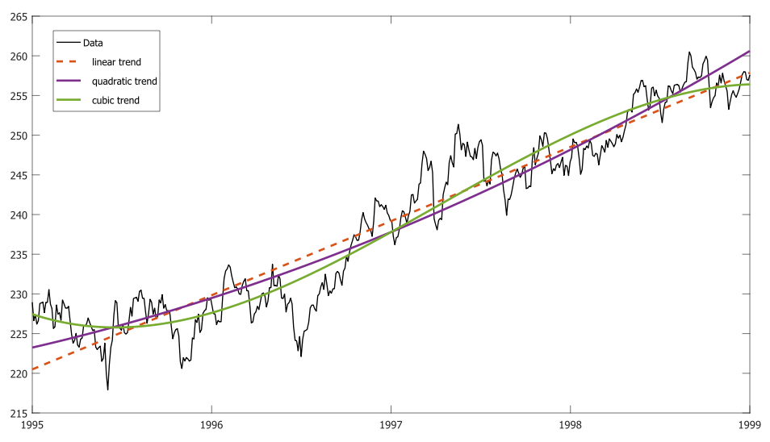

Slide 23
Trend estimation with smoothing
Estimate the trend as weighed mean of initial data points of time series with smoothing window of size (2L+1):
with weighting coefficients:

Slide 24
Moving mean = Running average
For example, smooth with 3 points:

Slide 26
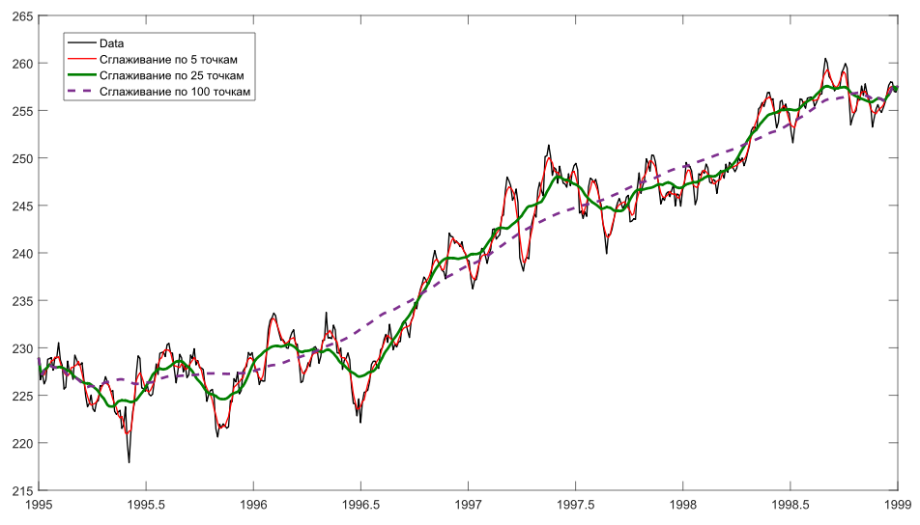

Slide 27
Exponential smoothing
The weighting coefficients are decreasing with the increase of number j;
The equation is constructed recursively, thus making it easier for a future trend forecast.

Slide 28
PART 3. Periodic components retrieval from stationary time series

Slide 29
General algorithm
Cycles and seasons = trigonometric components
Statistical tests for non-random components;
De-trend the time series;
De-noise the time series if possible;
According to the additive model, there are only seasonal and cycle components remain;
To estimate their periods/frequencies we can use spectrum harmonic analysis

Slide 30
Spectrum harmonic analysis
Fourier transform:
Fourier coefficients:

Slide 31
Spectrum harmonic analysis
We can correlate those Fourier coefficients with PSD estimate:
Then we can define from PSD diagram the corresponding frequency domain (domain K)
The periodic component is estimated as:

Slide 32
Spectrum harmonic analysis
Spectrum harmonic analysis works as intended only if:
Time series is stationary;
Nyquist–Shannon sampling theorem is satisfied;
Frequency resolution is adequate;
There are none spectrum leakages;
Estimated trigonometric modes are semi-periodic;
There are none frequency modulations;
There are small amplitude modulations;
Therefore, the usability of this method is scarce.

Slide 33
References
N. Golyandina, A. Zhigljavsky. Singular Spectrum Analysis for time series. — Springer Briefs in Statistics. — Springer. — 2013. — 120 p. ISBN 978-3-642-34912-6.
David R. Brillinger. Time Series: Data Analysis and Theory. — SIAM, 2001. — 540 p.

